Slide 1
Introduction to philosophy Lecture 6
PHI1101
Dr. Lucas Scripter
Lecturer in General Education
School of Humanities and Social Sciences
Chinese University of Hong Kong, Shenzhen

Slide 2

Three ways of conceiving of philosophy
Philosophy as a Way of Life
Philosophy as the Foundation of the Sciences
Philosophy as Conceptual Analysis

Slide 3
Philosophy as the foundation of the sciences (And its critics)

Slide 4
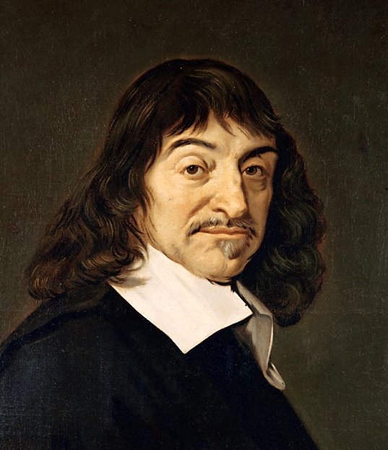
Rene Descartes (1596-1650)
Major Works
Discourse on Method (1637)
Meditations on First Philosophy (1641)
Principles of Philosophy (1644)
Passions of the Soul (1649)

Slide 5
Descartes’ vision of philosophy 1
Descartes re-interprets Philosophy as the ‘love of wisdom’:
“the word ‘philosophy’ means the study of wisdom, but ‘wisdom’ here does not simply mean prudence in practical life but, rather, a perfect knowledge of everything a human being can know, both as regards the conduct of life, and as regards the preservation of health and the discovery of arts; and that, in order for this knowledge to be perfect, it must be deduced from primary causes…and these principles must meet two requirements: first, they must be so clear and evident that the human mind cannot doubt of their truth when it sets itself attentively to consider them; and, secondly, the knowledge of other things must depend on them in such a way that they can be known independently of these other things, but that these other things cannot be known independently of them; and that we must then seek to deduce from these principles the knowledge of the things that depend on them, in such a way that there is nothing in the whole deductive sequence that is not completely manifest.” (Principles of Philosophy, p. 124)

Slide 6

Descartes’ vision of philosophy 2
In his Principles of Philosophy, Descartes (1644) compared human knowledge to a tree. This image reveals how he saw human knowledge as interconnected with philosophy as the foundation.
“the whole of philosophy is like a tree, the roots of which are metaphysics and the trunk physics, while the branches that grow rom the trunk are all the other sciences, which may be reduced to the principal ones, namely, medicine, mechanics, and ethics…” (p. 131)
Roots: Metaphysics
Trunk: Physics
Branches: various sciences (medicine, mechanics, morals)

Slide 7
Descartes’ skeptical method

Slide 8
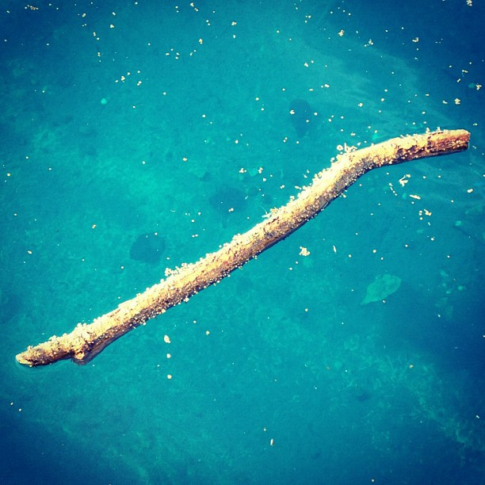
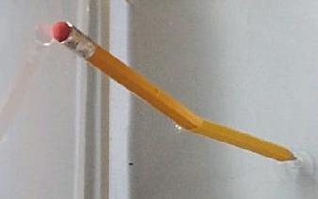
Optical illusions 1

Slide 9
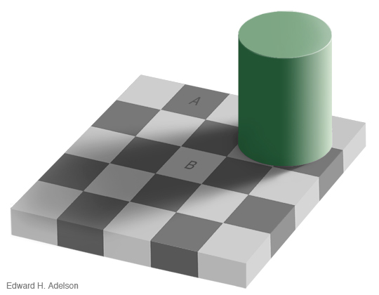
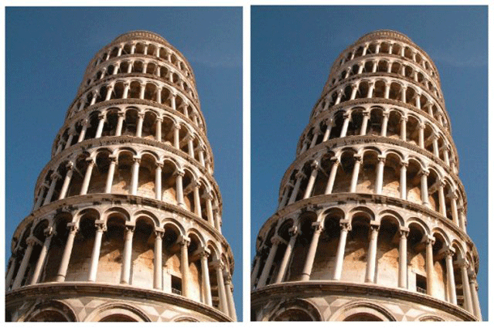
Optical illusions 2

Slide 10


Optical Illusions 3

Slide 11
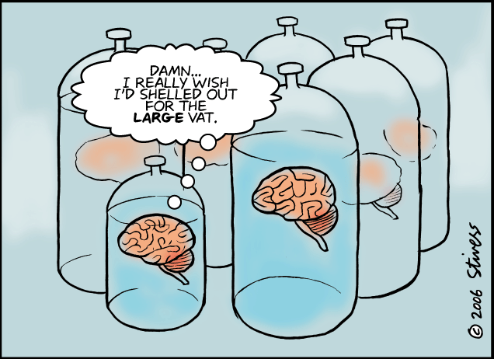
Brain-in-a-vat
Radical skepticism distrusts not just some of our sensory experience, but asks whether we can trust it in principle. Could all of our senses be deceiving us? This was Descartes’ worry.
One popular image for radical skepticism is the brain-in-a-vat thought experiment.

Slide 12
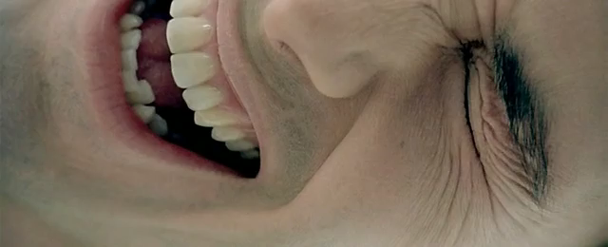
Radical skepticism in popular culture: the matrix (1999)

Slide 13

Descartes’ radical skepticism 1
Descartes’ first example of radical doubt is to ask whether we can be certain we aren’t dreaming. In dreams we mistakenly assume our senses tell us true things, when they don’t.
“there are no conclusive signs by means of which one can distinguish clearly between being awake and being asleep.” (Meditation 1, p. 97)

Slide 14
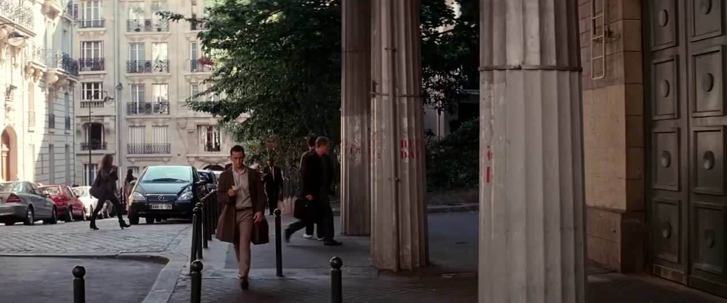
Radical skepticism in popular culture: inception (2010)

Slide 15

Descartes’ radical skepticism 2
Descartes offers the further skeptical example of an evil demon, who uses his sovereign power to mislead us.
“I shall suppose…that there is, not a true God, who is the sovereign source of truth, but some evil demon, no less cunning and deceiving than powerful, who has used all his artifice to deceive me. I will suppose that the heavens, the air, the earth, colours, shapes, sounds, and all eternal things that we see, are only illusions and deceptions which he uses to take me in. I will consider myself as having no hands, eyes, flesh, blood or senses, but as believing wrongly that I have all these things. I shall cling obstinately to this notion; and if, by this means, it is not in my power to arrive at the knowledge of any truth, at the very least it is in my power to suspend my judgment. This is why I shall take great care not to accept into my belief anything false, and shall so well prepare my mind against all the tricks of this great deceiver that, however powerful and cunning he may be, he will never be able to impose on me.” (Meditation 1, p. 100)

Slide 16

Descartes’ skeptical method
Descartes employs radical doubt to correct his reasoning:
“I shall proceed more prudently if…I endeavor to deceive myself, pretending that all these opinions are false and imaginary, until, having so balanced my prejudices that they may not make my judgment incline more to one side than to another, my judgment may no longer be overpowered as hitherto by bad usage and turned from the right path which can lead it to the knowledge of truth.” (Meditation 1, p. 100)

Slide 17
Two kinds of skepticism
Cartesian
ancient
Descartes’ skeptical method aims to arrive at certain knowledge.
He uses skepticism to clear away erroneous beliefs and identify a certain foundation on which he can build.
Pyrrhonian skepticism’s goal is tranquility of mind.
It seeks to lead a thinker through various arguments for and against a thesis to a suspension of belief (epoche).

Slide 18
Descartes “provisional moral code” for skepticism
Accept common practice; choose moderate options
Firmness and resoluteness
Focus on one’s own power
“My third maxim was to try always to conquer myself rather than fortune, and to change my desires rather than the order of the world, and generally to accustom myself to believing that there is nothing entirely in our power except our thoughts, so that after we have done our best regarding things external to us, everything in which we do not succeed is for us absolutely impossible.” (Discourse 3, p. 47)
Cultivate one’s reason

Slide 19
Descartes’ foundationalism

Slide 20

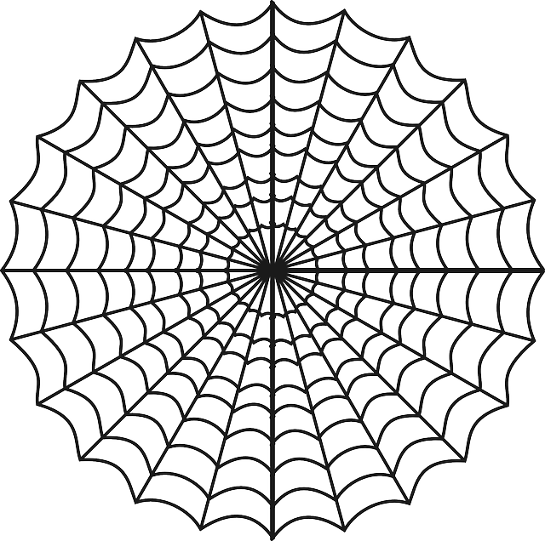
Two models of epistemology
Foundationalist
Coherentist

Slide 21

First principle of philosophy: cogito, ergo sum
Is there anything that cannot be doubted?
Descartes argued that I cannot doubt my own existence, because for me to doubt, I must exist to be doubting.
“I resolved to pretend that nothing which had ever entered my mind was any more true the illusions of my dreams. But immediately afterwards I became aware that, while I decided thus to think that everything was false, it followed necessarily that I who thought thus must be something; and observing that this truth: I think, therefore I am, was so certain and so evident that all the most extravagant suppositions of the sceptics were not capable to shaking it. I judged that I could accept it without scruple as the first principle of the philosophy I was seeking. (Discourse on Method 4, p. 54)

Slide 22
Clear & distinct ideas
Descartes offers the criterion of clear & distinct ideas for true beliefs.
“having noticed that there is nothing at all in this, I think, therefore I am, which assures me that I am speaking the truth, except that I see very clearly that in order to think one must exist, I judged that I could take it to be a general rule that the things we conceive very clearly and very distinctly are all true…” (Discourse 4, p. 54)
Clear
Distinct
(See Principles of Philosophy, sec. 45-6)

Slide 23

What is the ‘I’?
Descartes characterizes the ‘I’ of the ‘I think’ as a “thinking substance”—not the everyday, embodied self of common sense.
“But what, then, am I? A thing that thinks. What is a thing that thinks? That is to say, a thing that doubts, perceives, affirms, denies, wills, does not will, that imagines also, and which feels.” (Meditation 2, pp. 106-7)
“I was a substance, of which the whole essence or nature consists in thinking, and which, in order to exist, needs no place and depends on no material thing; so that this ‘I’, that is to say, the mind, by which I am what I am, is entirely distinct from the body…” (Discourse on Method 4, p. 54)

Slide 24


Two kinds of substance
corporeal
thinking

Slide 25
Descartes’ arguments for god’s existence

Slide 26
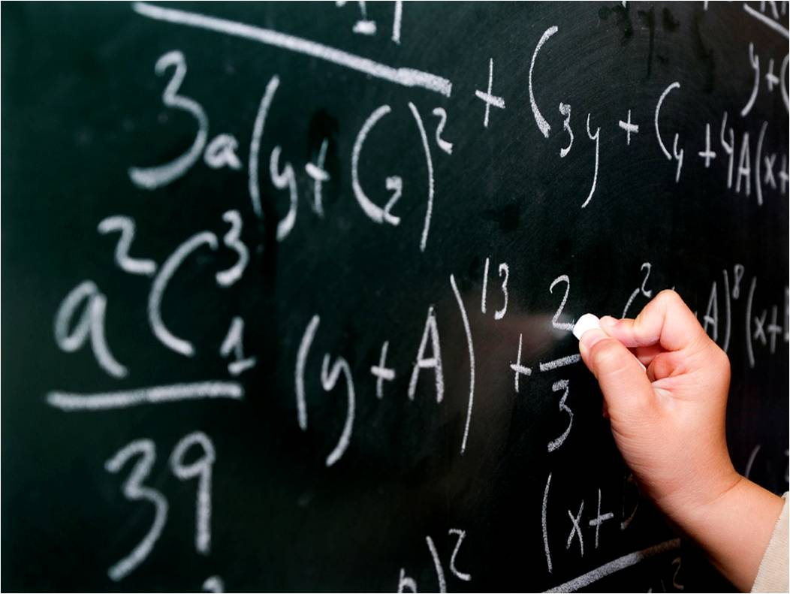
Problem of the evil deceiver, again
An evil demon could make even things that seem clear and distinct unreliable:
“a God might perhaps have given me a nature such that I might make mistakes even concerning the things which seem the most obvious to me. But every time this preconceived opinion of the sovereign power of a God presents itself to my mind, I am, constrained to admit that it is easy for him, if he wishes, to arrange that I fall into error, even in things which I believe I know with the very greatest certainty.” (Meditation 3, p. 114)

Slide 27


Descartes’ ontological argument 1
Descartes sets out to prove that God exists and that he wouldn’t deceive us.
Principle—the more perfect cannot come from the less perfect: “there must be at least as much reality in the efficient and total cause as in its effect: for whence can the effect draw its reality if not from its cause?” (Meditation 3, p. 119)
“it would not be possible for my nature to be as it is, that is to say, that I should have in me the idea of a God, if God did not really exist; this same God, I say, the idea of whom is in me, that is to say, who possess all these high perfections of which the mind may will have some idea without, however, begin able fully to understand them, who is not subject to any defects, and who has none of the things which indicate some imperfection.” (Meditation 3, p. 131)

Slide 28


Descartes’ ontological argument 2
Descartes argues that the very concept of God requires that he must exist.
God’s essence includes his existence.
“existence can no more be separated from the essence of God than the fact that the sum of its three angles is equal to two right-angles can be separated from the essence of a triangle or that the idea of a mountain can be separated from the idea of a valley; so, that is to say, there is no less contradiction in conceiving God, that is to say, a supremely perfect being, who lacks existence, that is to say, who lacks some particular perfection, than in conceiving a mountain without a valley.” (Meditation 5, p. 145).

Slide 29

Descartes on free will
Descartes affirms that the will is free and this gives us the ability to decide what we will affirm or reject.
“we can always abstain from believing in whatever is not fully certain and properly investigated; and thus we can take care never to be mistaken.” (Principles of Philosophy, sec. 6)

Slide 30

Explanation of error
Where does error come from?
Descartes argues that human beings have two faculties: perception & volition.
Error arises when we affirm things beyond the proper bounds of our knowledge.
“Whence, then, arise my errors? From this fact alone, that the will being much more ample and extended than the understanding, I do not contain it within the same limits, but extend it also to things I do not understand, and the will being of itself indifferent to such things, very easily goes astray and chooses the bad instead of the good, or the false instead of the true, which results in my falling into error or sinning.” (Meditation 4, p. 137)

Slide 31
bibliography
Descartes, Rene (1968). Discourse on Method and Other Writings. Penguin.
Descartes, Rene (2015). The Passions of the Soul and Other Writings. Oxford.
Frankfurt, Harry (2008). Demons, Dreams and Madmen. Princeton.

